Slide 1
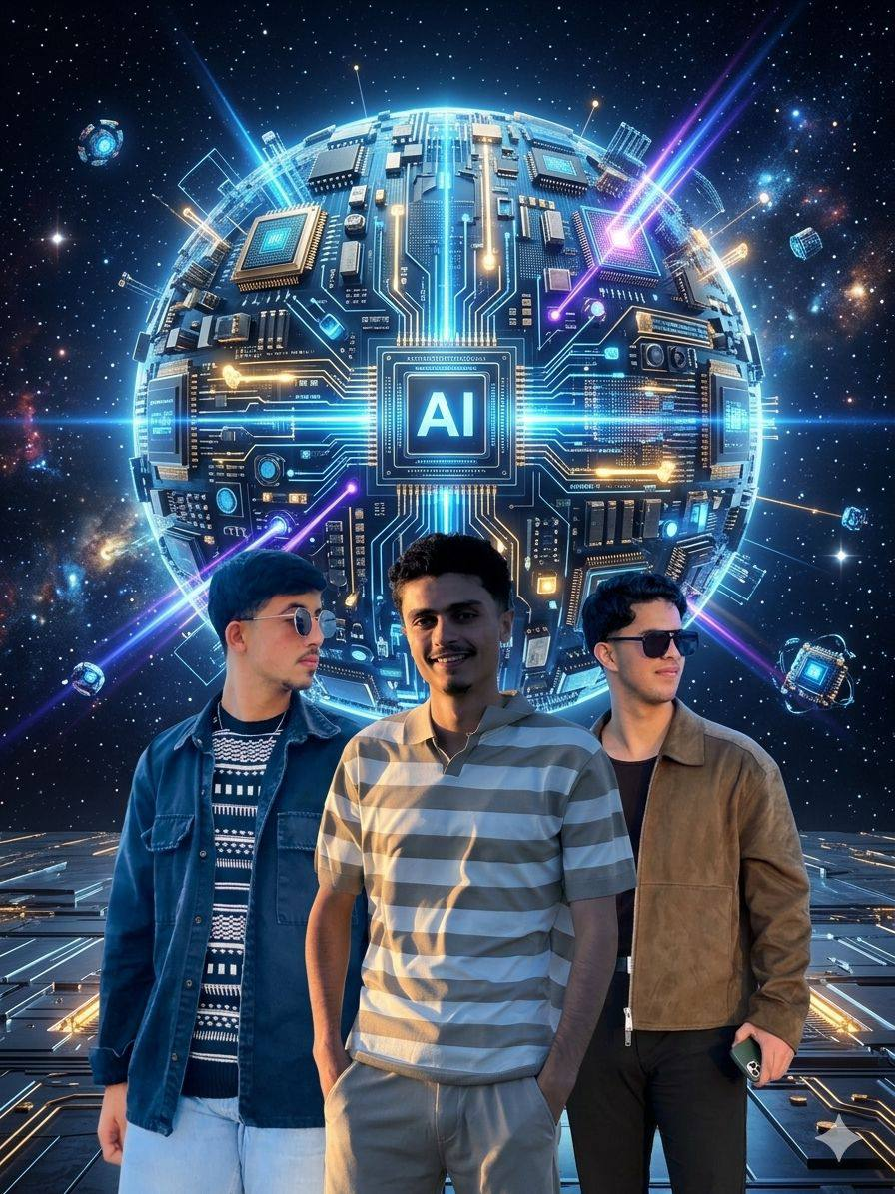
AI GRADUATION PROJECT
SMART
VIEW
AI
"Transforming Vision into Intelligent Audio Guidance"
Prepared by: Wael Saadeh · Omar Saadeh · Ali Abed Al Wahed
Supervisor: Dr. Rami Sefarjaleni

Slide 2





PROJECT IDEA
SMART VIEW AI converts visual information from the surrounding environment into real-time audio guidance and safety alerts for visually impaired users.
Detects Objects
Spatial Awareness
We will make the phone the eyes of the blind and the computer his brain, so that his environment is suitable for him and away from dangers.
Identifies surrounding items in real-time
Announces left/right positions
Distance Filter
Currency Detection
Ignores irrelevant far objects
Custom-trained money recognition model

Slide 3

SMART FILTERING & TRACKING
Distance Filter
Person
Chair
Problem: AI detects EVERYTHING — including far, irrelevant objects.
Large
= Close
ID: 1
ID: 2
Small
= Far
✓ Announced
✓ Announced
✗ Same object announced repeatedly
Engineering Logic:
Far objects: shown visually, no voice
✗ Audio spam overwhelms the user
Close objects: voice announced
✗ System becomes unusable
Reduces cognitive overload
Cleaner, faster audio feedback

Slide 4
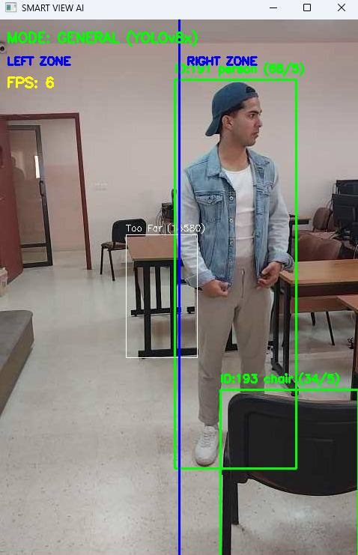
YOLOv8x OBJECT DETECTION
We used YOLOv8x — the most accurate variant — because real-time accuracy matters more for blind users than marginal speed gains.
📷
[ Add Image Here ]
Click to replace with your photo
High Accuracy
Real-Time Speed
Object Priority Levels
Priority 1
CRITICAL
Person · Car · Bus · Motorcycle · Truck · Bicycle
Priority 2
MODERATE
Chair · Couch · Bed · Door · Table · Bench
Priority 3
GENERAL
80+ everyday objects (bottles, bags, etc.)

Slide 5
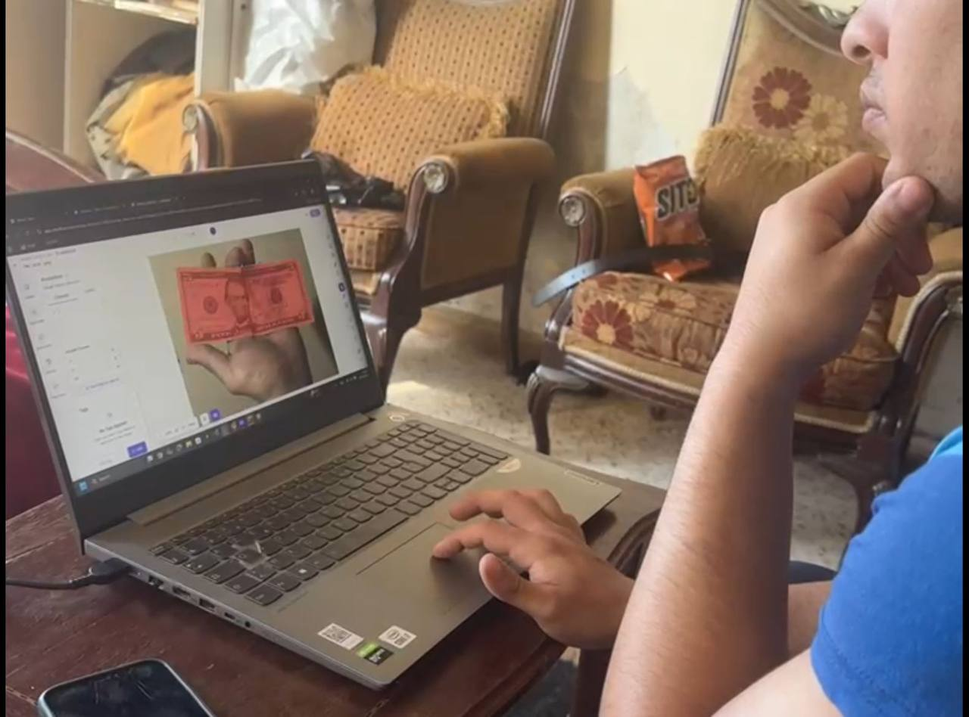
CURRENCY RECOGNITION SYSTEM
A completely custom-trained YOLO model (best.pt) built using Roboflow — separate from the general detection model.
📷
[ Add Image Here ]
Click to replace with your photo
Two Operating Modes
Mode 1 — General Detection
YOLOv8x · 80+ COCO objects
Low confidence img size
Focus: navigation safety
$100
🔊 "100 Dollars"
Press
2
$20
🔊 "20 Dollars"
$5
🔊 "5 Dollars"
$50
🔊 "50 Dollars"

Slide 6
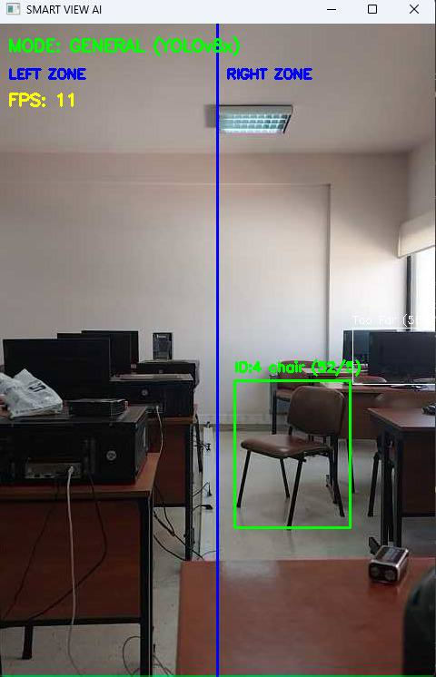
LEFT / RIGHT SPATIAL AWARENESS
The screen is split into two zones. The AI announces the object AND its direction.
📷
[ Add Image Here ]
Click to replace with your photo
LEFT ZONE
👤
Person
Person
ID: 1
🔊 "Person on the LEFT"

Slide 7

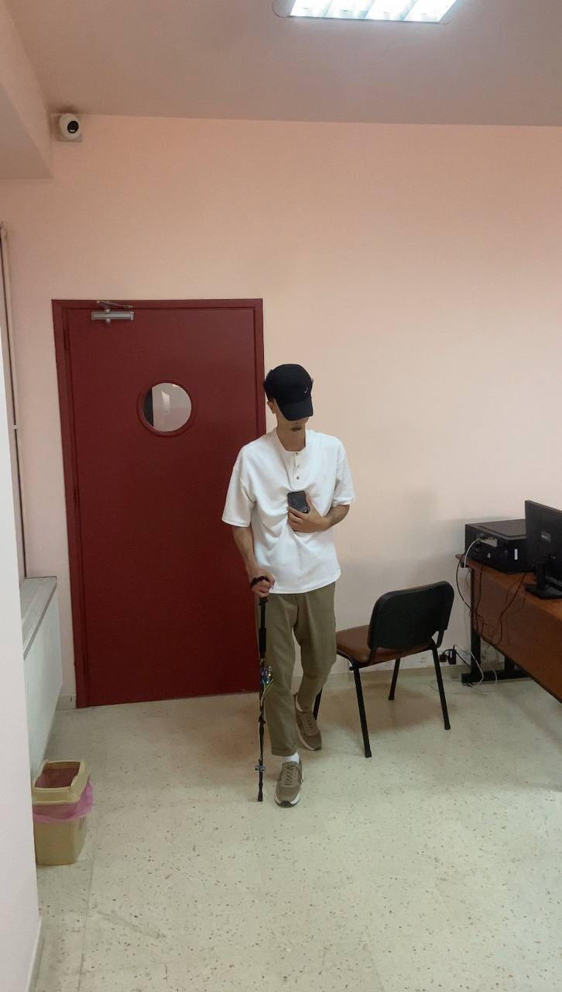
CONVERTING WEAKNESSES INTO STRENGTHS
Every engineering challenge became a design advantage:
📷
[ Add Image Here ]
Click to replace with your photo
⚠ CHALLENGE
Repeated speech alerts
Too many detected objects
Error in understanding and analising
Limited hardware budget

Slide 8
ETHICAL STATEMENT
This project was created for Accessibility, Humanitarian Assistance, and Ethical Technological Advancement — NOT for commercial exploitation.
♿
Accessibility
For all visually impaired
🤝
Humanitarian
Serving developing countries
⚖️
Ethical AI
Technology for good
Our mission: Using Artificial Intelligence to improve human life.

Slide 9

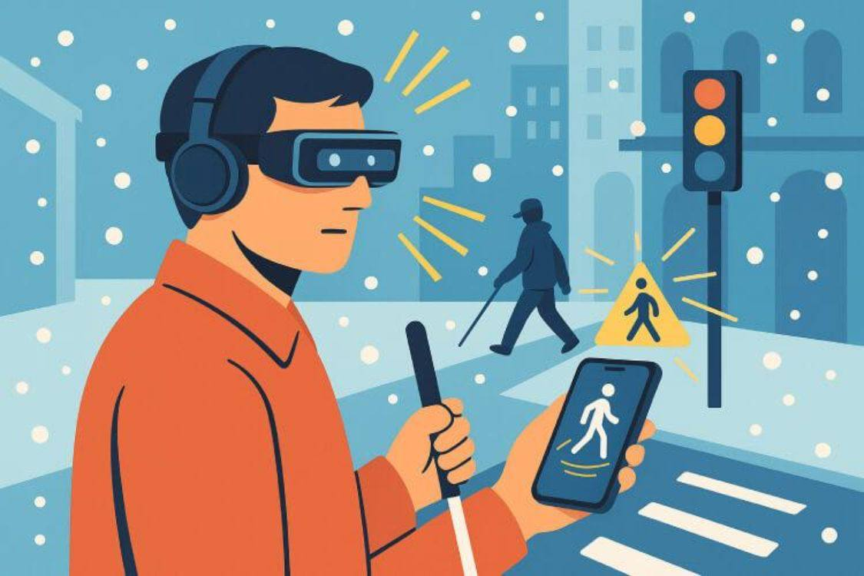



FUTURE ROADMAP
📷
[ Add Image Here ]
Click to replace with your photo
Offline access
Smart Glasses
The future version will not require a local network , it will be completely offline
"
Lightweight wearable camera
Haptic Feedback
Mobile App
Reading Mode
Vibration and connection between the stick and the brain
Full smartphone deployment
The ability to enjoy reading without learning anything

Slide 10
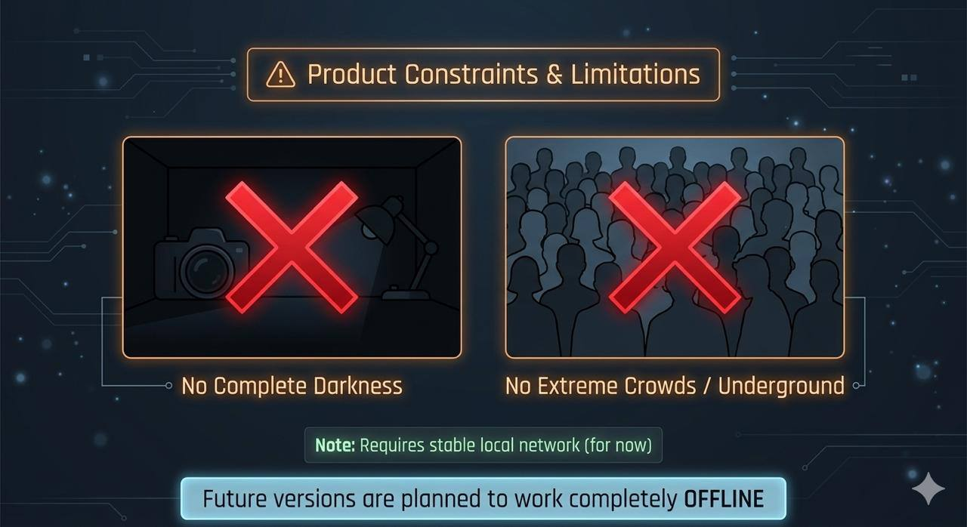
WORKING ENVIRONMENT & LIMITATIONS
✅ Ideal Conditions
Normal lighting conditions
Indoor & outdoor environments
Moderate object density
Local network available
📷
[ Add Image Here ]
⚠ Current Limitations
Complete darkness
Underground / extreme crowding
Requires local network (for now)

Slide 11

CONCLUSION
SMART VIEW AI is more than an object detection system.
📷
[ Add Image Here ]
Click to replace with your photo
Real-Time
Assistive Platform
Scalable AI
Architecture
Vision → Sound AI → Assistance Technology → Accessibility
"The value of SMART VIEW AI is not in detecting objects, but in transforming environmental information into real-time guidance that helps blind people navigate the world more safely and independently."

Slide 12

THANK YOU
SMART VIEW AI
Questions? We are ready to discuss.
Wael Saadeh · Omar Saadeh · Ali Abed Al Wahed
Supervisor: Dr. Rami Sefarjaleni

